Slide 1
The 10 Most Destructive Garden Pests and How to Get Rid of Them
Deborah Determan, Feb 11, 2021
Information from : https://www.goodhousekeeping.com/home/gardening/a20705991/garden-insect-pests/ and https://www.fix.com/blog/common-garden-pests-and-how-to-get-rid-of-them/ and https://gilmour.com/tomato-problems-diseases-pests

Slide 2
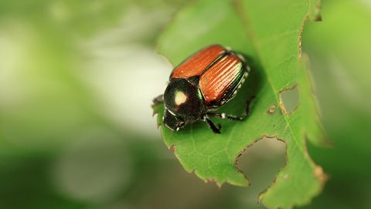
Japanese Beetles
Adults are metallic blue-green, ½-inch beetles with bronze wing covers, while larvae are fat, white grubs with brown heads. They can be found on many vegetables, flowers, and small fruit in all states east of the Mississippi River. Adults skeletonize leaves, chew flowers, and may completely defoliate plants while larvae feed on lawn and garden plant roots. To control these pests:
  Shake beetles from plants in early morning
  Apply floating row covers
  Set out baited traps upwind of your garden on two sides and at least 30 feet away
  Spray beetles with insecticidal soap

Slide 3
We all grow tomatoes, don’t we?
3 Sure Signs of Pests
Leaves or fruits are partially eaten, have holes, or insect tracks are evident
Visibly seeing animals, eggs or larvae of aphids, weevils, or caterpillars on or near plants
Seedlings disappear completely or plants are defoliated
5 Sure Signs of Diseases
Leaves start yellowing or develop brown or black spots
Leaf tips turn brown, curl, or shrivel
A white film develops on leaf surfaces
Fruits have soft spots, rotted stems, or are moldy
Seedlings tip over or bend near the base of the stem shortly after the germination process

Slide 4
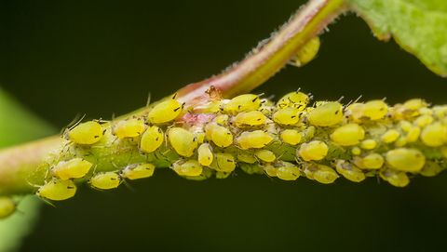
Often found on the undersides of leaves or feeding in clusters
They can be difficult to see, but if ants are present, then aphids generally are too as ants like to feed off the sugary honeydew that’s a byproduct of aphid feeding.)
Aphids are sap sucking creatures that cause plants to weaken, stunting growth and cause leaves to become misshapen.
To rid your plants of aphids, use a heavy stream of water to knock them off leaves. Then spray plants with soapy water.
Encourage natural predators
Cover if feasible, or apply the repellents listed
Aphids
These tiny, pear-shaped critters have long antennae and two tubes projecting rearward from their abdomen. They usually hang out on most fruits and vegetables, flowers, ornamentals, and shade trees throughout North America. Aphids suck plant sap, causing foliage to distort and leaves to drop; honeydew excreted on leaves supports sooty mold growth; and feeding spreads viral diseases. To control these bugs:
  Wash plants with strong spray of water
  Encourage native predators and parasites such as aphid midges, lacewings, and ladybugs
  When feasible, cover plants with floating row covers
  Apply hot-pepper or garlic repellent sprays
  For severe problems, apply horticultural oil, insecticidal soap, or neem oil
Notes:
Often found on the undersides of leaves or feeding in clusters
They can be difficult to see, but if ants are present, then aphids generally are too as ants like to feed off the sugary honeydew that’s a byproduct of aphid feeding.)
Aphids are sap sucking creatures that cause plants to weaken, stunting growth and cause leaves to become misshapen.
To rid your plants of aphids, use a heavy stream of water to knock them off leaves. Then spray plants with soapy water.
Encourage natural predators
Cover if feasible, or apply the repellents listed

Slide 5
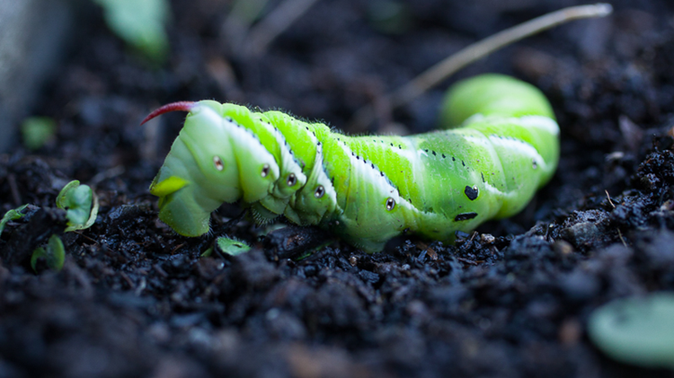
Tomato horn worms
Aphids
.
Tomato horn worms are large caterpillars with a horn-like tail.
You’ll find eggs or caterpillars on or near plants in the tomato family. Or you’ll discover the leaves of your tomato have disappeared. Tomatoes are the preferred host plants of these larvae.
When you see them, pick them off and put them in soapy water. It’s also helpful to keep your garden weed free. These same tips also apply to other caterpillars

Slide 6
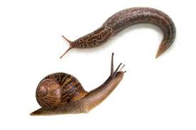
Slugs and snails
Slugs and snails love tomatoes as much as you and me.
If you find leaves and fruits with large holes, slugs or snails are near. Look for accompanying slime trails to positively identify. The best remedies for slugs and snails:
First, water plants directly and not the entire garden. (Slugs and snails prefer moist environments.)
Next, inspect plants regularly and handpick any unwanted visitors.
If the problem persists, employ traps and/or barriers.
  Place a shallow dish filled with beer near plants to trap slugs and snails (they’ll climb in and die) or sprinkle a ring of diatomaceous earth around plants to prevent them from reaching crops.

Slide 7
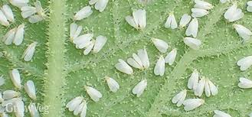
Whiteflies
Whiteflies are bright white, winged insects that form large colonies on the undersides of leaves. They’re highly visible and, when leaves are moved or disturbed, will fly off in small white clouds of bugs.
Like aphids, they’re sap suckers that cause plants to weaken.
Spray plants using a heavy stream of water with your watering nozzle and apply insecticidal soap.

Slide 8
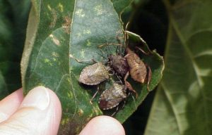
Brown Marmorated Stink Bugs
The brown marmorated stink bug is native to parts of Asia and was first observed in the U.S. in Allentown, PA in 2001. It took up residence in parts of Washington County and has steadily migrated to other parts of Maryland.
Adults congregate in late summer/early fall and actively seek safe overwintering sites-especially inside buildings. Then they emerge and mate in spring.
They are not harmful to people, houses, or pets. They do not bite, sting, suck blood, or spread disease and they don’t eat or bore into wood. The BMSB feeds on plant leaves, buds, and fruits.
While stinkbugs damage most vegetables, they tend to be fond of tomato and pepper plants.
Mechanical exclusion is the best method to keep stink bugs from entering homes and buildings. First, attempt to locate the openings where the insects gain access. Keep these points in mind when choosing a method for controlling BMSB:
The BMSB is a strong flier and will quickly “drop” downward when disturbed.
They emit a strong, unpleasant odor when threatened or crushed. The smell goes away quickly.
They are more sluggish on cool, overcast days.
They tend to congregate late summer/fall on warm, elevated surfaces.
Pesticides are generally ineffective and not recommended for controlling this pest inside or outside your home.
Spraying the bugs with a stream of water will dislodge them but they will probably return.

Slide 9
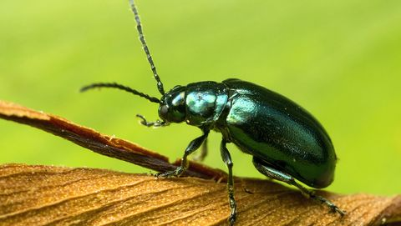
Flea Beetles
Flea beetles are double trouble.
They are small, dark beetles that jump like fleas when disturbed. They hang out on most vegetable crops and are found throughout North America. Adults chew numerous small, round holes into leaves (most damaging to young plants), and larvae feed on plant roots. For control:
  Sprinkle plants with diatomaceous earth
  Introduce beneficial nematodes to soil
  Place row covers over young plants.
  Spray plants with garlic spray or kaolin clay

Slide 10
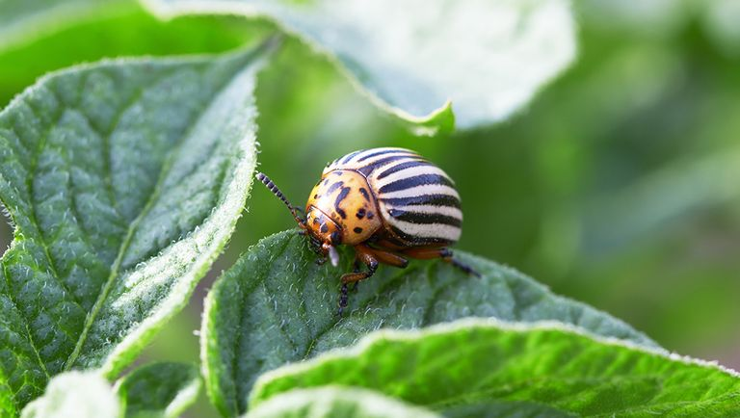
Colorado Potato Beetle
Adults are yellow-orange beetles with ten black stripes on wing covers. They're found on potatoes, tomatoes, cherry tomatoes, eggplant, and petunias throughout North America. These beetles defoliate plants, reducing yields or killing young plants. To control:
  Apply floating row covers
  Use deep straw mulches
  Hand pick
  Attract native parasites and predators
  Spray with neem oil

Slide 11
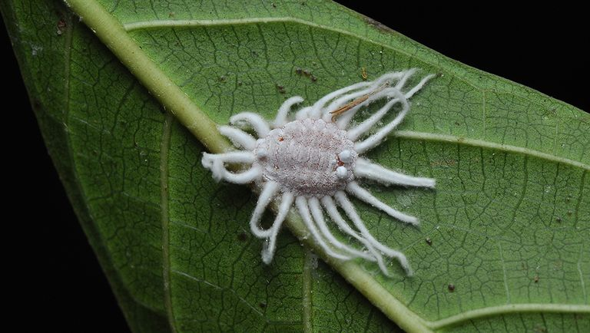
Aphids
Scales
Adult females look like hard or soft bumps on stems, leaves, or fruit; males are minute flying insects and larvae are tiny, soft, crawling insects with threadlike mouthparts. They can be found on many fruits, indoor plants, ornamental shrubs, and trees throughout North America. All stages suck plant sap, therefore weakening plants. Plants become yellow, drop leaves, and may die. Honeydew is also excreted onto foliage and fruit. For control:
  Prune out infested plant parts
  Encourage native predators
  Scrub scales gently from twigs with soft brush and soapy water, and rinse well
  Apply dormant or summer oil sprays
  Spray with neem oil
  This content is created and maintained by a third party, and imported onto this page to help users provide their email addresses. You may be able to find more information about this and similar content at piano.io

Slide 12
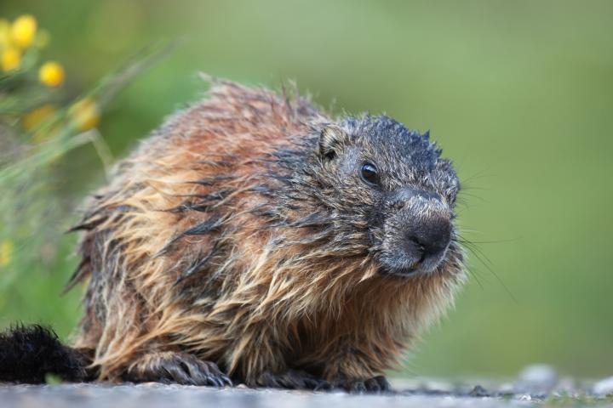
Aphids
Groundhog
The problem is that groundhogs—also known as woodchucks or whistle-pigs—are binge eaters who can wipe out your vegetable garden in a matter of minutes. They climb, they burrow, they swim, and they eat—an adult consumes about a pound to a pound-and-a-half of vegetation daily. Between spring and fall, they double their body weight.
Soon after they emerge from a winter’s hibernation, they mate, giving birth in mid-spring—at a time when the picking are at their slimmest. Groundhogs will often devour your seedlings before they even have time to grow. Groundhogs eat mostly during the early morning and afternoon, so try to see when your garden is receiving the most damage. These creatures will also gnaw and claw at fruit trees, so check your trees for any such marks.
Sprinkle blood meal, ground black pepper, dried blood, or talcum powder around the perimeter of your garden.
Puree and strain hot peppers and garlic, mix them with water and enough liquid soap to make it stick, and spray it liberally around the garden.
Put some harmless but strong-smelling substance just inside the burrow (such as urine-saturated clumps of kitty litter). Loosely seal the entrance, so the smell stays inside. Fox, coyote, wolf, and bobcat urines are among the scents now sold as groundhog repellents.
Eliminate woodpiles and other places where groundhogs nest.
Keep undergrowth and grass cover low to deter groundhogs.
Groundhogs are always looking for vacant burrows. Close down their tunnel systems.
Unfortunately, humane traps and relocation may be the only solution.
The best woodchuck deterrent is a fence. Since groundhogs climb and also burrow, you’ll need to build a secure enclosure using six-foot-wide woven-wire fencing. Above ground, the fence should be about four feet high, with the top 12 inches unattached to fence posts (i.e., floppy and facing away from the garden, so that when a groundhog tries to go over the top, its weight will flip it back). The two feet of fencing buried underground should form an L-shape, with 12 inches going straight down and the bottom 12 inches bent at a right angle away from the garden.
An apron of weighed-down black plastic around the garden discourages some diggers.

Slide 13
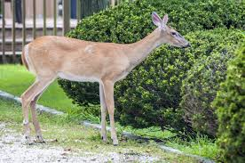
Deer
No. 1: Choose Deer-Resistant Outdoor Plants.
No. 2: Place Bar Soap Near Outdoor Plants.
No. 3: Scatter Human Hair Around Outdoor Plants.
No. 4: Apply a Deer-Repellant Spray to the Outdoor Plants.
No. 5: Add a Motion Sensor Near the Outdoor Plants.
No. 6: Physically Protect Your Garden Plants Against Deer.

Slide 14
Fortunately, nature offers plenty of non-toxic ways to discourage and manage detrimental insects. The following 6 steps can help a gardener reduce pest problems without toxic chemicals. Remember: Prevention is always the first and best line of attack.
1. Build Healthy Soil
Soil supplies the nutrients, water, oxygen, and root support that plants need to thrive. Research shows that the healthier the soil, the better plants are able to withstand pest attacks. Building healthy, fertile, living soil is the most important way to prevent pest problems.
Build healthy soil with these five practices:
  • Limit Soil Disturbance
  A growing body of research suggests that routinely turning the soil has various drawbacks. It leaves the soil
  surface bare, encourages runoff, causes soil compaction and erosion, and harms soil microbes and earthworms.
  Keeping disturbance to a minimum preserves the living systems in soil. Instead, layer amendments on top, and let
  the earthworms aerate the soil.
  • Compost
  Start a compost bin and add one to two inches of well-decomposed compost to the garden each spring to
  supplement nutrition in the soil and encourage a desirable soil structure.
  • Mulch
  Add two to four inches of grass clippings or mowed leaves to the garden when plants are about four inches high
  to reduce water evaporation, suppress weeds, moderate soil temperature, prevent soil compaction, and add
  slowly-decomposing organic matter to the soil.
  • Rotate crops
  Crop yields decrease when plants are repeatedly sown in the same beds. That’s partly because soil-dwelling
  pest populations, such as grubs, wireworms, and maggots, increase. Rotate plant families to new beds each
  season to keep pests on the run.
  • Plant cover crops
  At the end of the growing season, plant a crop cover such as ryegrass, peas, or clover, to enhance the soil’s
  fertility, lessen erosion over winter months, suppress weeds, and improve the soil structure. In spring, cover the
  crop with mulch or allow chickens to graze.

Slide 15
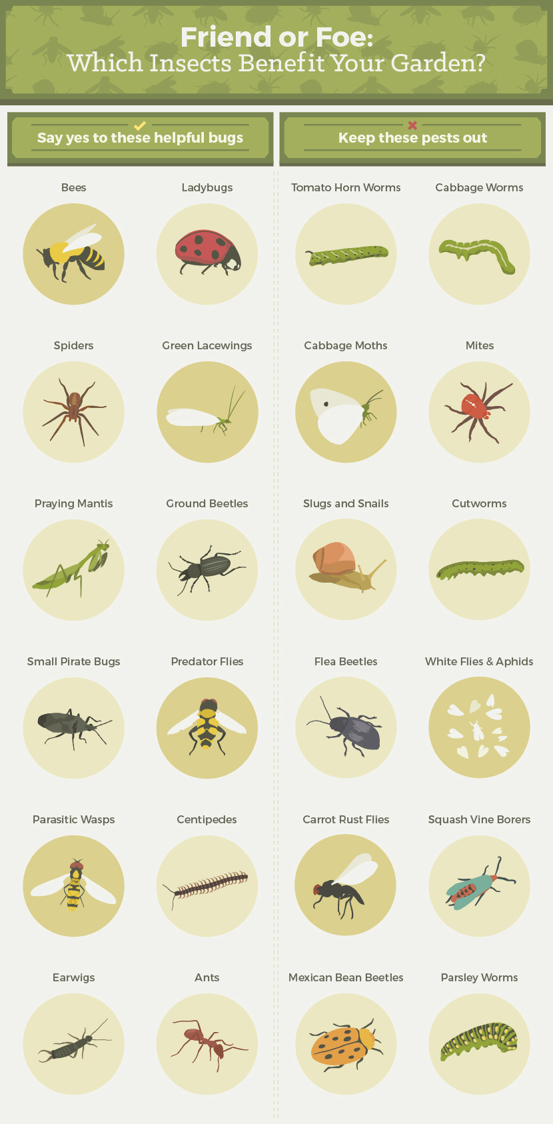
2. Attract Beneficial Predators
Remember, not all bugs are bad. Many actually help plants grow by pollinating, decomposing waste, and gobbling up pests. The trick is to know which bugs benefit your plants and which can become a problem.
In general, keep the garden as diversified as possible and encourage year-round blooming to attract varying types of beneficial insects. The following plants are particularly attractive to the predators that help control pest populations:
  • Native flowering plants, especially those with daisy-shape blooms
  • Tansy
  • Fennel
  • Mint
  • Carrots
  • Dill
  • Sweet alyssum
  • Marigolds
  • Parsley
  • Coriander
  • Zinnia

Slide 16
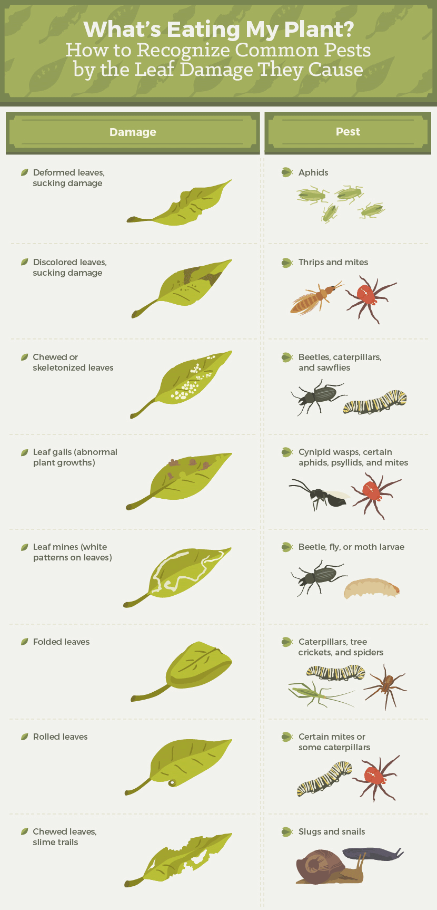
3. Monitor the Garden
The truth is, every gardener will share some harvest with pests. Even in a garden with healthy soil that is buzzing with beneficial insects, it’s a good idea to closely monitor crops for pest damage. Be sure to check the undersides of leaves, where bugs hide and leave egg sacs.

Slide 17


4. Decide Whether to Tolerate or Take Action
If pest damage is minimal, organic gardeners may simply want to tolerate pests, since any pest control can also harm beneficial pollinators and predators.
It’s usually safe to eat slightly damaged produce, so long as you follow these rules of thumb:
  • Toss anything that’s been munched on by rodents or raccoons.
  • Toss anything that an animal has defecated on.
  • Toss any leaves that have a squiggly white decoration. It’s caused by leaf miners, which are still inside the leaves.
  • It’s generally safe to eat produce that has a few holes or has been nibbled on by insects. Cut off damaged areas and enjoy the rest.
If pest damage is too high to tolerate, start with the least invasive control method.

Slide 18
5. Mechanical Pest Solutions
These hands-on techniques use simple equipment, devices, or natural ingredients to provide a protective barrier between plants and insects. Although the devices or ingredients may seem non-toxic and harmless, many can injure or harm bees and other beneficial bugs. It’s always important to be selective.
  • Barriers
  Nets, fences, and paper collars keep bugs and other animals away from plants. Floating row covers -- transparent plastic or fabric covers that let sunshine in – keep beetles, flea beetles, and many other pests at bay. Barriers can prevent pollination, so row covers and nets should be raised while flowers are blooming.
  • Handpicking
  Plucking pests and egg sacks off plants by hand is an effective and non-toxic way to control them, although it can be labor-intensive.
  • Traps
  Mechanical traps lure pests away from plants, allowing them to be removed from the garden. Various traps can be purchased at garden stores or made at home. Build your own slug and snail trap by nailing strips of wood on a board. Place it in the garden, with the strips down, so the board is slightly propped off the ground. Slugs and snails will climb under it and can be easily escorted away from the garden.
  • Water Pressure Sprays
  A forceful stream of water dislodges aphids and spider mites, but the process must be repeated regularly. Only use on sturdy plants, and allow plants to dry between sprays to prevent disease caused by over-watering.

Slide 19
5. Mechanical Pest Solutions (continued)
• Insect Vacuums
  Handheld, battery-powered vacuums can be used to remove bugs from plants. Shake the plant and vacuum the pests that fall or fly off.
• Food Grade Diatomaceous Earth
  Diatomaceous earth, a powder made from fossilized aquatic organisms, penetrates the exoskeleton of bugs, dehydrating and killing them. Sprinkle it around the stems of plants to keep crawling pests away. It is safe for humans and pets, although it should not be breathed in. It only works when dry, so reapply after rain and watering. Diatomaceous earth kills both pests and beneficial insects.
• Insecticidal Soap
  Spraying diluted soap on plants can deter a number of pests. Use a natural soap with no detergent or additives, such as castile soap. Try 5 tablespoons of soap per gallon of water and test on a small portion of the plant. If the spray causes leaf damage, dilute further. Soap kills both pests and beneficial insects.
• Horticultural Oils
  Horticultural oils are petroleum- or plant-based oils mixed with emulsifiers so they can be added to water and sprayed on plants. They smother and poison scale, aphids, mites, and other soft-bodied insects. Horticultural oils kill both pests and beneficial insects.

Slide 20
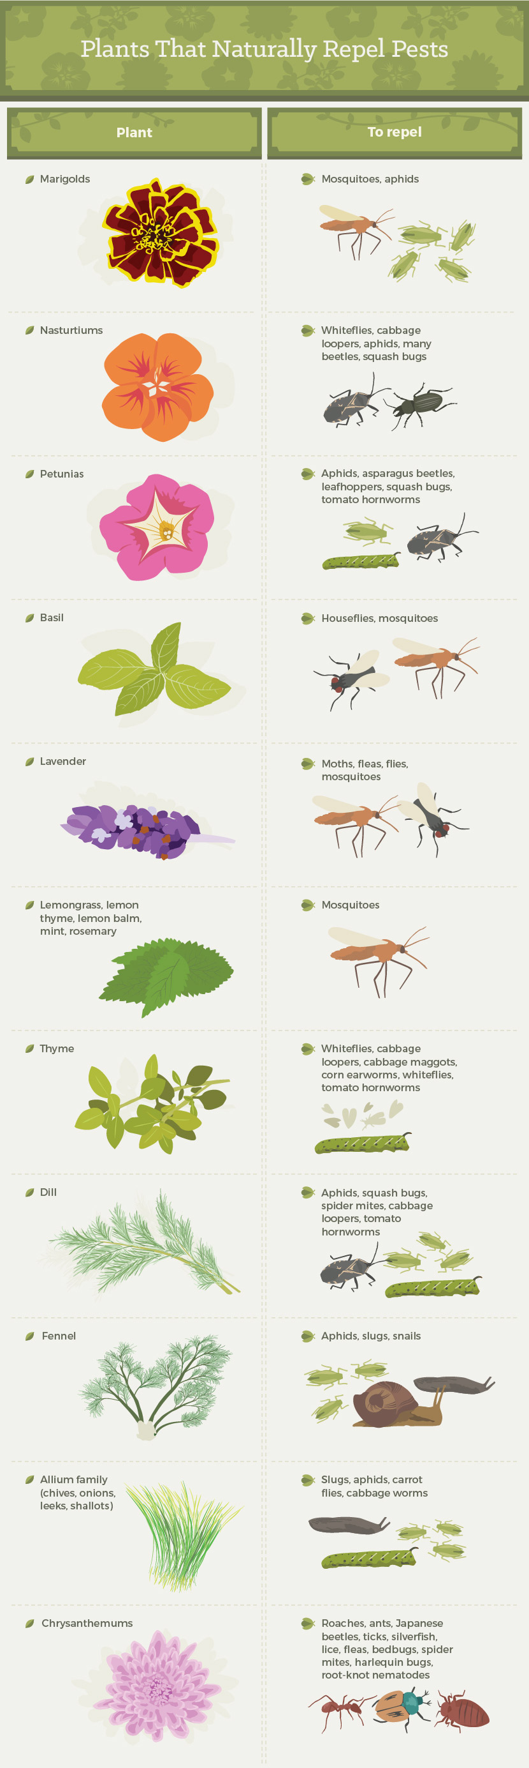


Slide 21
6. Chemical Cures
If all else fails, it may be time to try an organic pesticide. Use only chemicals approved by the USDA for use by organic growers, and use them selectively. Start with the least toxic and most specific remedy first, and apply it in the evening when bees are least active.
The Xerces Society for Invertebrate Conservation offers these guidelines on the organic mechanical and chemical pesticides that are safest for bees:
Non-Toxic
Bacillus thuringiensis
Garlic
Kaolin clay
Corn gluten
Gibberellic acid
Moderately Toxic
Boric acid
Neem
Ryania
Adjuvants
Horticultural vinegar
Copper
Lime sulfur and sulfur
Highly Toxic
Diatomaceous earth
Insecticidal soap and oil
Pyrethrins
Rotenone
Sabadilla
Spinosad
Copper sulfate

Slide 22
